Slide 1
Game Theoretical Approach on Multi-Agent Reinforcement Leaning
Lim Jin Xing
Sai Ganesh Nagarajan

Slide 2
Contents
Introduction of Reinforcement Learning (RL) and Multi Agent Reinforcement Learning (MARL)
Challenges in MARL
Game Theoretical Approach on MARL with example
Aim - Understanding Reward Structure in MARL settings

Slide 3
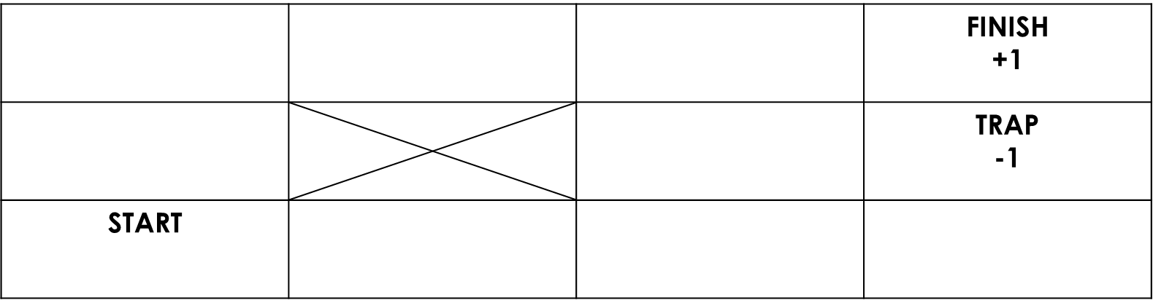

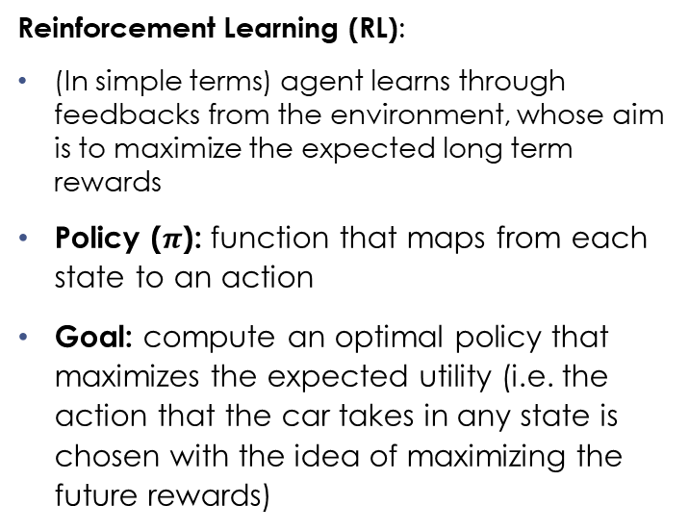
Reinforcement Learning (RL)
Reinforcement Learning (RL):
(In simple terms) agent learns through feedbacks from the environment, whose aim is to maximize the expected long term rewards
Policy ($π$): function that maps from each state to an action
Goal: compute an optimal policy that maximizes the expected utility (i.e. the action that the car takes in any state is chosen with the idea of maximizing the future rewards)
An example of RL

Slide 4

Multi-Agent Reinforcement Learning (MARL)
Multi-Agent Reinforcement Learning (MARL):
(In simple terms) agents (more than 1) share the same environment and each agent tries to maximize its own expected long term rewards, which is subjected to state of the environment and actions taken by other agents
START (Car A) |  |  | FINISH (Car B) (-1, +1)
 |  |  | FINISH (Car A) (+1, -1)
START (Car B)
A
B
An example of MARL

Slide 5
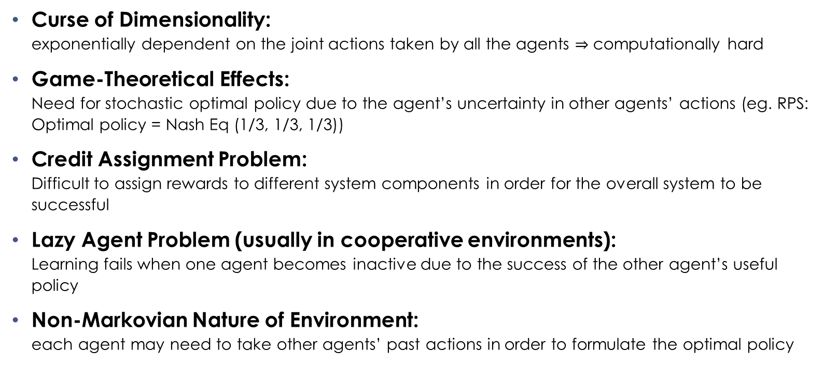
Challenges in MARL [Kapoor ‘18]
Curse of Dimensionality: exponentially dependent on the joint actions taken by all the agents $⇒$ computationally hard
Game-Theoretical Effects: Need for stochastic optimal policy due to the agent’s uncertainty in other agents’ actions (eg. RPS: Optimal policy = Nash Eq (1/3, 1/3, 1/3))
Credit Assignment Problem: Difficult to assign rewards to different system components in order for the overall system to be successful
Lazy Agent Problem (usually in cooperative environments): Learning fails when one agent becomes inactive due to the success of the other agent’s useful policy
Non-Markovian Nature of Environment: each agent may need to take other agents’ past actions in order to formulate the optimal policy
Kapoor, S. (2018). Multi-Agent Reinforcement Learning: A Report on Challenges and Approaches.

Slide 6
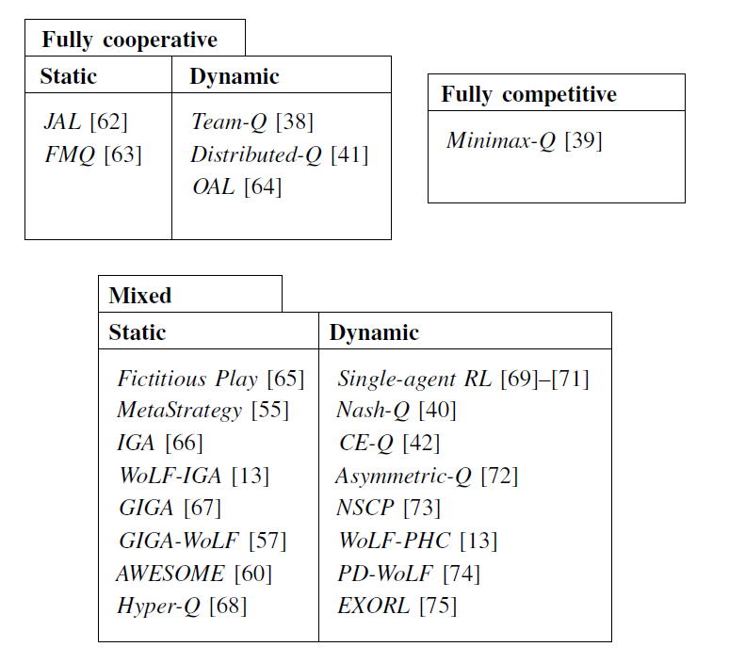
Why Use Game Theory?
Game Theory: (Wikipedia) study of mathematical models of strategic interaction between rational decision-makers (maximize utility or minimize cost)
Similar to what each agent is trying to achieve in MARL
So are there example(s) on game theoretical approach on MARL?
MARL algorithms based on type of task [L. Bus¸oniu, et al ‘08]
L. Bus¸oniu, R. Babuˇska, and B. De Schutter, “A comprehensive survey of multi-agent reinforcement learning,” IEEE Transactions on Systems, Man, and Cybernetics, Part C: Applications and Reviews, vol. 38, no. 2, pp. 156–172, Mar. 2008.

Slide 7
A Unified Game-Theoretic Approach to Multiagent Reinforcement Learning
Marc Lanctot, Vinicius Zambaldi, Audrunas Gruslys, Angeliki Lazaridou, Karl
Tuyls, Julien Perolat, David Silver, and Thore Graepel. 2017.
Marc Lanctot, Vinicius Zambaldi, Audrunas Gruslys, Angeliki Lazaridou, Karl Tuyls, Julien Perolat, David Silver, and Thore Graepel. 2017. A Unified Game-Theoretic Approach to Multiagent Reinforcement Learning. In Advances in Neural Information Processing Systems 30, I. Guyon, U. V. Luxburg, S. Bengio, H. Wallach, R. Fergus, S. Vishwanathan, and R. Garnett (Eds.). 4190–4203.

Slide 8
Independent RL VS Policy-Space Response Oracles
Independent RL (InRL)
Policy-Space Response Oracles (PSRO) *NEW*
Simplest form of MARL
Each agent is oblivious to the other agents and simply treats all the interactions between them as part of its “localized” environment
Uses empirical game theoretical analysis to compute meta-strategies for policy selection

Slide 9
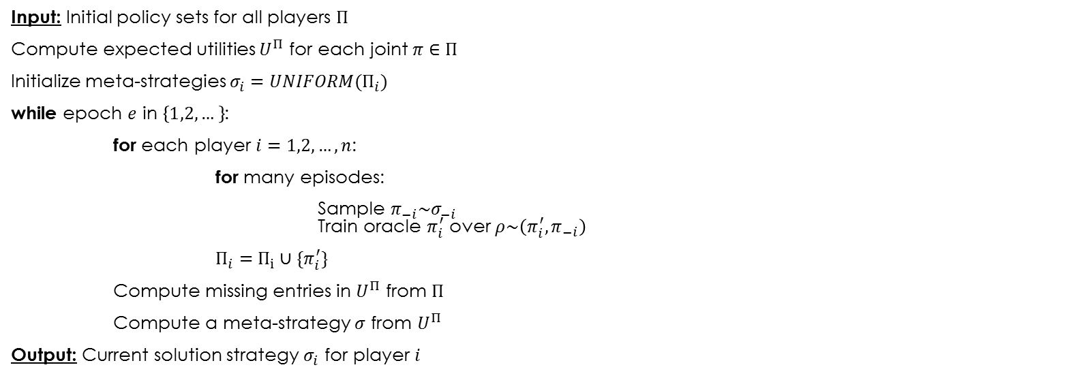
PSRO Algorithm
Input: Initial policy sets for all players $Π$
Compute expected utilities $U^{Π}$ for each joint $π∈Π$
Initialize meta-strategies $σ_{i}=UNIFORM(Π_{i})$
while epoch $e$ in $\left\{1,2,…\right\}$:
for each player $i=1,2,…,n$:
for many episodes:
Sample $π_{−i}\sim σ_{−i}$ Train oracle $π_{i}^{′}$ over $ρ\sim \left(π_{i}^{′},π_{−i}\right)$
$Π_{i}=Π_{i}∪\{π_{i}^{′}\}$
Compute missing entries in $U^{Π}$ from $Π$
Compute a meta-strategy $σ$ from $U^{Π}$
Output: Current solution strategy $σ_{i}$ for player $i$
RL Process (Reactor [Gruslys, et al ‘17])
Meta-Strategy Solver (empirical game-theoretic analysis):
Regret Matching
Hedge
Projected Replicator Dynamics (PRD) *NEW*
Audrunas Gruslys, Mohammad Gheshlaghi Azar, Marc G. Bellemare, and Remi Munos. The Reactor: A sample-efficient actor-critic architecture. CoRR, abs/1704.04651, 2017.

Slide 10
Experiments (2-Players Laser Tag)
What each agent can see:
All spaces in front and sides
2 spaces behind
Actions:
Turn left or right
Step forward, backward, left, right or remain stationary
Cast endless laser beam in its current direction
Each episode: 1000 steps of simulation
Winner: Tag opponent twice (1 point)
Loser: Respawn at one of the spawn point
P |  |  |  |  |  | P
P |  |  |  |  |  | P
Map of Laser Tag Environment

Slide 11
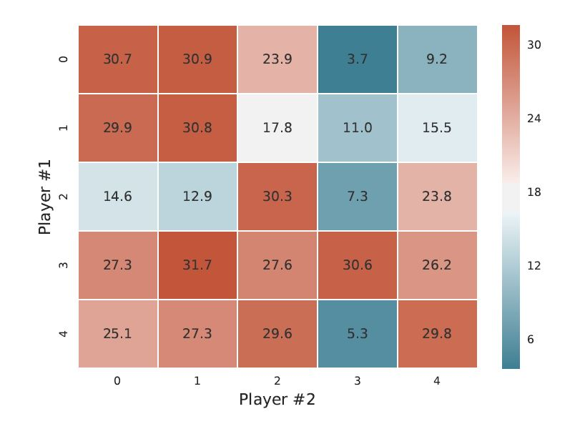
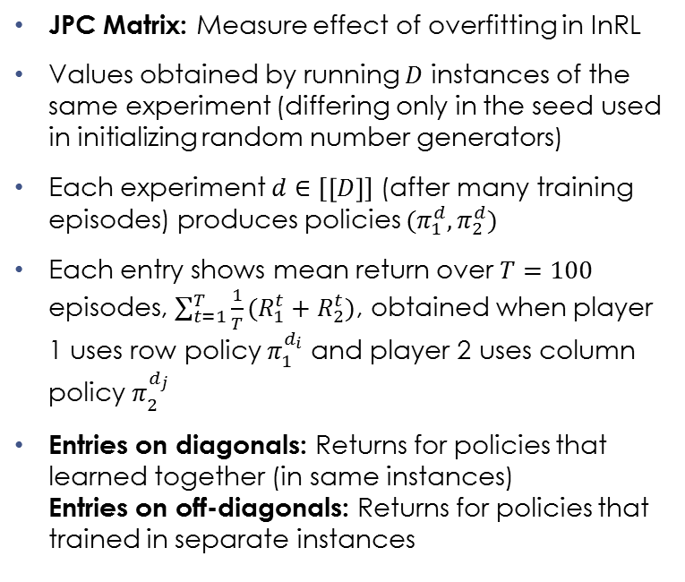
Joint Policy Correlation (JPC)
JPC Matrix: Measure effect of overfitting in InRL
Values obtained by running $D$ instances of the same experiment (differing only in the seed used in initializing random number generators)
Each experiment $d∈[\left[D\right]]$ (after many training episodes) produces policies $(π_{1}^{d},π_{2}^{d})$
Each entry shows mean return over $T=100$ episodes, $\sum_{t=1}^{T}{\frac{1}{T}(R_{1}^{t}+R_{2}^{t})}$, obtained when player 1 uses row policy $π_{1}^{d_{i}}$ and player 2 uses column policy $π_{2}^{d_{j}}$
Entries on diagonals: Returns for policies that learned together (in same instances) Entries on off-diagonals: Returns for policies that trained in separate instances
JPC matrix for InRL

Slide 12
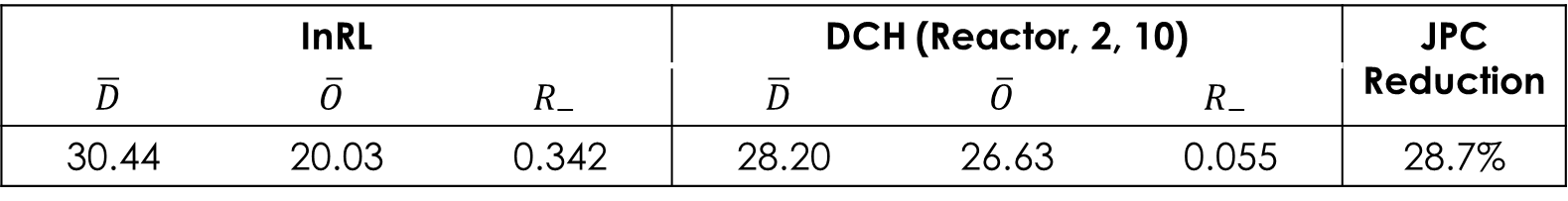

Results
Average proportional loss in reward as $R_{−}=(\overline{D}−\overline{O})/\overline{D}$
$\overline{D}$: mean value of the diagonals $\overline{O}$: mean value of the off-diagonals
$↑R_{−}⇒ ↑$ overfitting
InRL |  |  | DCH (Reactor, 2, 10) |  |  | JPC Reduction
$$\overline{D}$$ | $$\overline{O}$$ | $$R_{−}$$ | $$\overline{D}$$ | $$\overline{O}$$ | $$R_{−}$$
30.44 | 20.03 | 0.342 | 28.20 | 26.63 | 0.055 | 28.7%

Slide 13
Aims
In multi agent in RL one key problem is to set the reward structure that will enable the system to reach the desired behavior.
We need to understand how much rewards can a system obtain in an episodic whilst learning in a normal form game.
How do we measure the learning progress of all the agents in each episode?
This is non-trivial especially when the game is a symmetric zero-sum game [Balduzzi, et al ‘19].
Balduzzi, David, et al. "Open-ended Learning in Symmetric Zero-sum Games." arXiv preprint arXiv:1901.08106 (2019)

Slide 14
High Level Ideas
We have to understand how the “game dynamics” behave in reinforcement learning settings.
The agent behavior and the rewards accrued will thus depend heavily on the behavior of these dynamics.
We view it more in terms of a “controllability” problem or a “dynamical mechanism design”
RL slightly deviates from traditional game theoretic or online learning settings as the agents may be enforced with a correlated policies while training, however traditionally we look at individual deviations and selfish actions.

Slide 15
Further Readings
K. Tuyls, J. Perolat, M. Lanctot, J. Z. Leibo, and T. Graepel, “A Generalised Method for Empirical Game Theoretic Analysis ,” in AAMAS, 2018.
K. Tuyls and A. Now´e. Evolutionary game theory and multi-agent reinforcement learning. The Knowledge Engineering Review, 20(1):63–90, March 2006.
Y. Yang, R. Luo, M. Li, M. Zhou, W. Zhang, and J. Wang, “Mean field multi-agent reinforcement learning,” in Proc. of the 35th ICML (J. Dy and A. Krause, eds.), vol. 80 of Proc. of Machine Learning Research, (Stockholmsmassan, Stockholm Sweden), pp. 5571– ¨ 5580, PMLR, July 2018.
Balduzzi, David, et al. "Open-ended Learning in Symmetric Zero-sum Games." arXiv preprint arXiv:1901.08106 (2019).

